Slide 1

Calculating FTE

Slide 2

About us
This program is designed to generate enrollment and FTE reports for courses given at Fayetteville Technical Community College based on current enrollment.
Designed by: Karen Brown
Thuan Chau
Harley Coughlin
Teresa Hearn
Shaine Ransford
Latoya Winston

Slide 3
What is Generated fte?
Total Full-Time Equivalent (FTE) credits produced by student enrollment in specific courses or programs
Basically, because not all students are fulltime, this allows the school to add up all the time all the students spend in class to figure out how many full-time students that would equal

Slide 4
WHY DOES ftcc NEED THIS?
In a nutshell, schools need to know their generated full time equivalent for financial decisions and program decisions.
Its all about a dollar!
Colleges can receive funding based on their total FTE. By creating a program that accurately and quickly calculated generated FTE, the school can ensure that they are receiving fair funding based on how many students they are serving.
Generated FTE data also ensures resources are being allocated appropriately during budgeting.
Okay, maybe it’s not all $$
FTE data is used to determine staffing (high FTEs means the need for more instructors and vise versa). The data can also be used to see which programs are currently gaining the most interest and therefor influence expansions or reductions.
Lastly, FTCC needs to report these numbers to the Department of Education to ensure federal compliance.

Slide 5
HOW is fte calculated?
5 x18 = 90
This class section has 18 out of the total 24 seats filled
This class is 5 contact hours.
Multiply contact hours by 16 (the number of weeks in the semester) to get total contact hours for semester
Multiple by the number of students enrolled in this section
Divide by 512(1 FTE = 512 contact hours) to get total FTE
90 x 16 = 1440
1440/512 = 2.8125
CSC-221-0001 has 2.8125 total FTEs

Slide 6
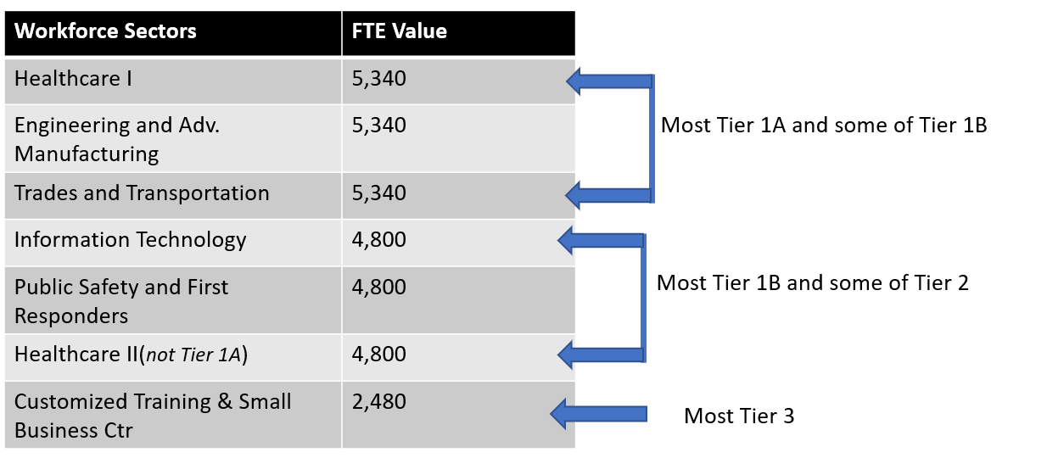
How does that translate to $$$
Sectors are categorized into tiers that determine funding levels: 1A, 1B, 2, and 3
CSC-221 belongs to tier 1B
Instruction pay for tier1B is $4,800
All courses receive $1,926 for institutional and academic support
Add the instruction pay to the support value to get total funds
To determine how much a course would generate take the total FTE and multiply by total funds
This course generates $18,916.88
$4800 + $1926 = $6726
$6726 x 2.8125 = $18916.88

Slide 7

Let’s simplify that for those of us not in finance
1 full time student = 1 whole pizza
Each slice is a part of the student’s time in class(like a few contact hours)
Each student in a class contributes their one slice of pizza
How many whole pizzas can this class make? (Total FTEs)
Each class gets the same starting amount and then an additional amount based on the type of pizza they create.
The amount of money a class generates is based on the total number of pieces it creates.
The more pizzas a class can make, the more they get paid! If a class is making a lot of pizzas, maybe we should expand our pizzeria and hire more head pizza chefs.

Slide 8
Requirements
Menu driven web-based python program and an executable file (this program utilized steamlit)
The following options are provided
Retrieve a report for section division (can be one, multiple, or all) that includes section information
Retrieve a report of the course enrollment percentage and total FTE(a sharp number) for a specific course section
Retrieve a report of the generated FTE for all courses under a single division (including totals for each course)
Retrieve a report of the generated FTE for all course sections for a Faculty member (including totals per division)
Retrieve a report of the generated FTE for all sections under a single course
All reports will be sorted by section division, then section name, then faculty (duplicate course sections will be discarded) and saved as an Excel file
Unittesting will be included to prevent any unexpected crashes
A flowchart to map out flow of program for client

Slide 9
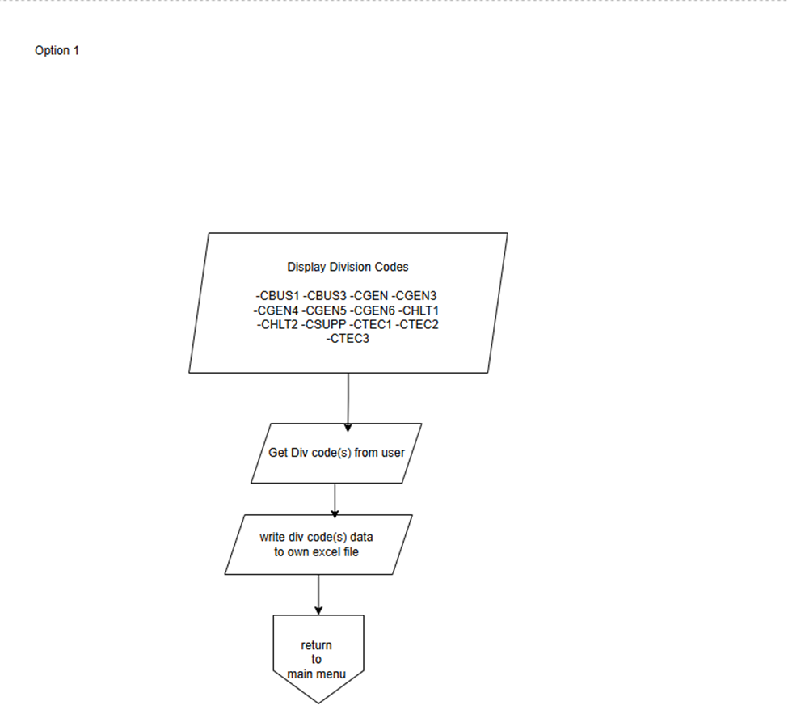
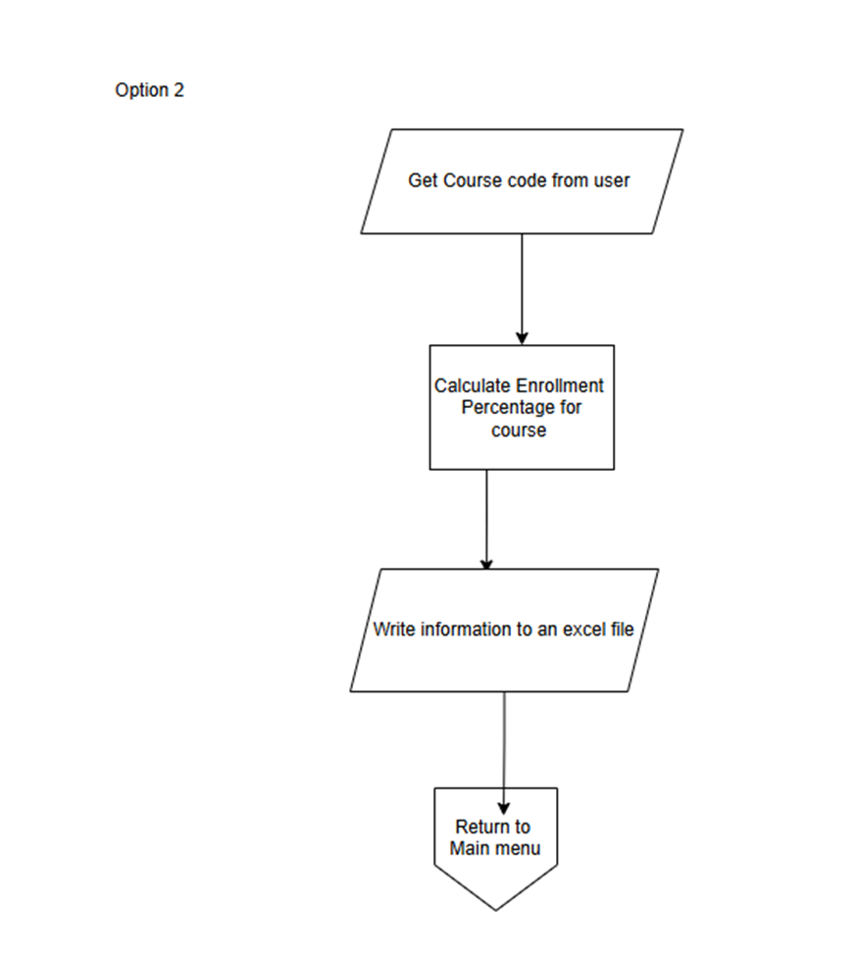
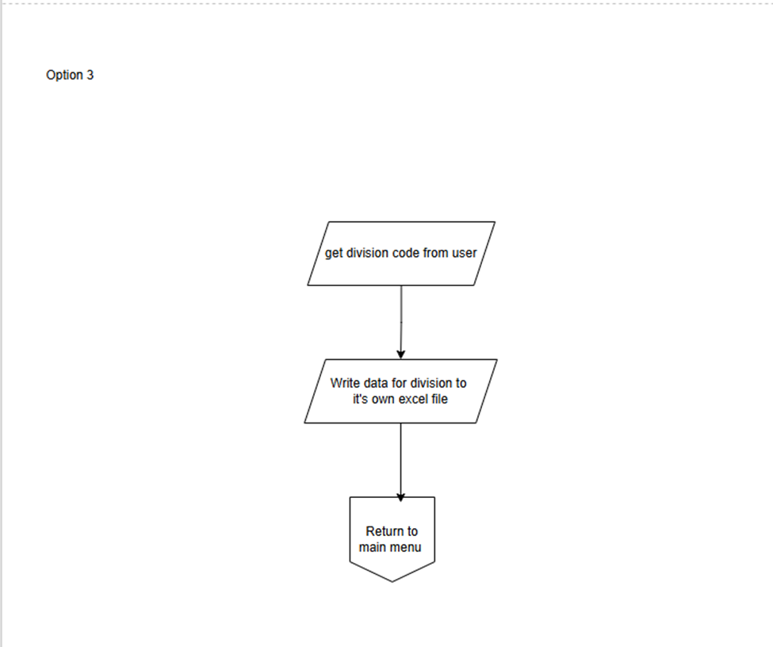
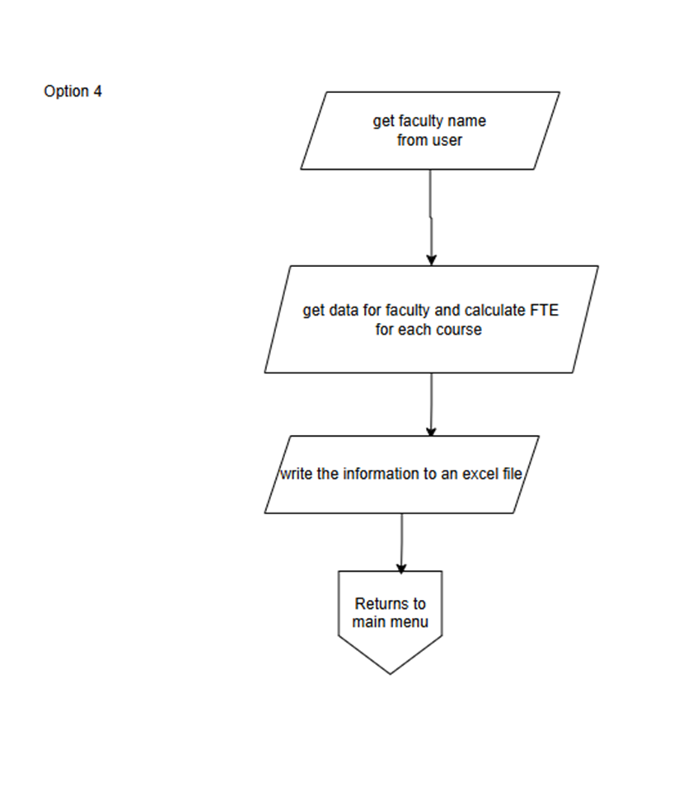
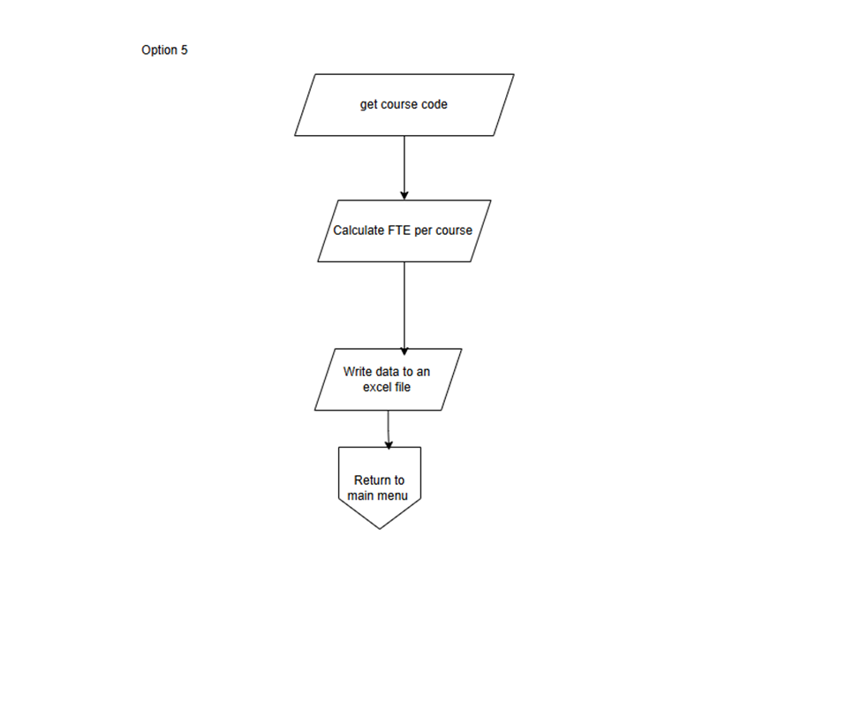
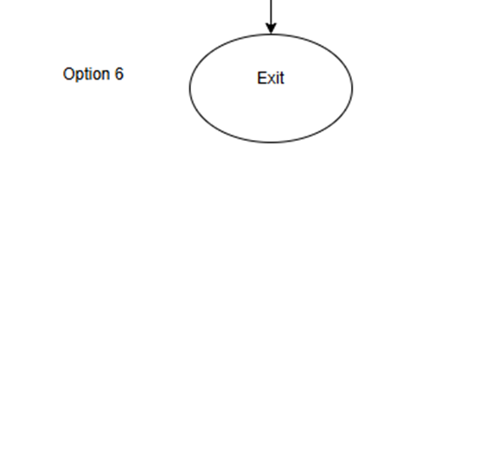
FLOWCHART

Slide 10
Add screen shot here

Slide 11
Add screen shot here

Slide 12
Add screen shot here

Slide 13
Add screen shot here

Slide 14
Add screen shot here

Slide 15
Add screen shot here

Slide 16
Add screen shot here

Slide 17
Add screen shot here

Slide 18
Add screen shot here

Slide 19
Add screen shot here

Slide 20
Group Member Involvement
We worked collectively on all aspects of the program, however we each had a task we were lead for
Karen – recalculating FTE function
Thuan/Shaine – creating the GUI
Harley – Unittesting
Teresa/Shaine – merging the files
Latoya – flowchart
Karen/Teresa – Powerpoint

